Slide 1


QWERTY x FITKING
Qwerty Brand Solutions

Slide 2

Scope Of Work
Website Maintenance & Upgradation.
Social Media Marketing.
SEO.
Google Business Page SEO.
Google Ads.
Third Party Service (AMAZON)

Slide 3


Why does this scope of work arise ?
We Reviewed THE competition.
      https://ironbullstrength.com
      https://sfhealthtech.com
      https://www.fitness-world.in

Slide 4
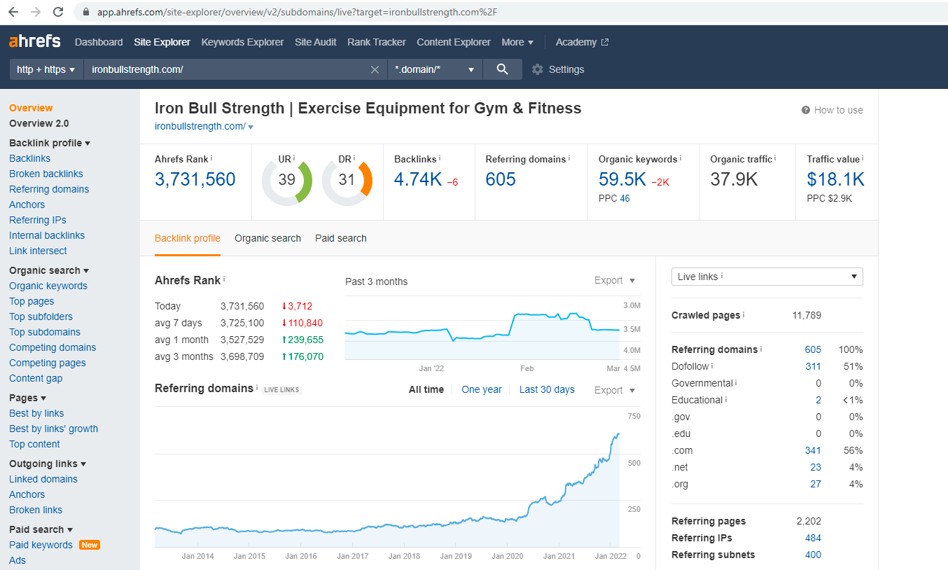
Why does this scope of work arise ?
Iron Bull Strength is diverting traffic to their website

Slide 5
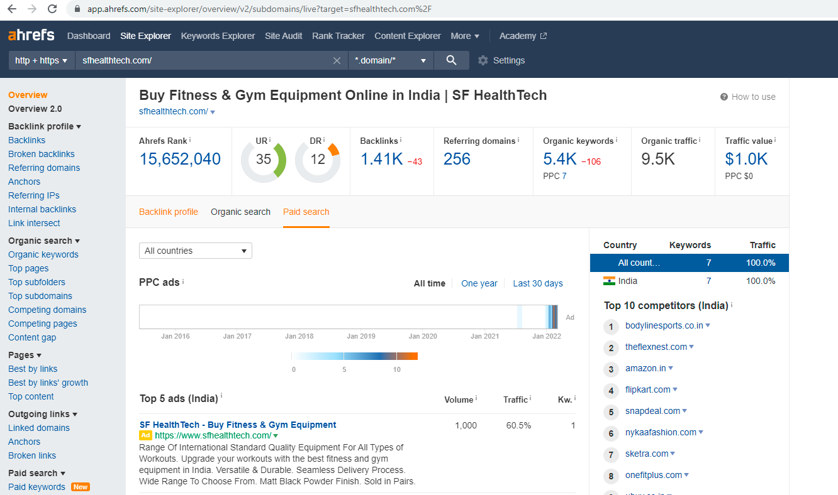
Why does this scope of work arise ?
SF Healthtech is diverting traffic to their website

Slide 6
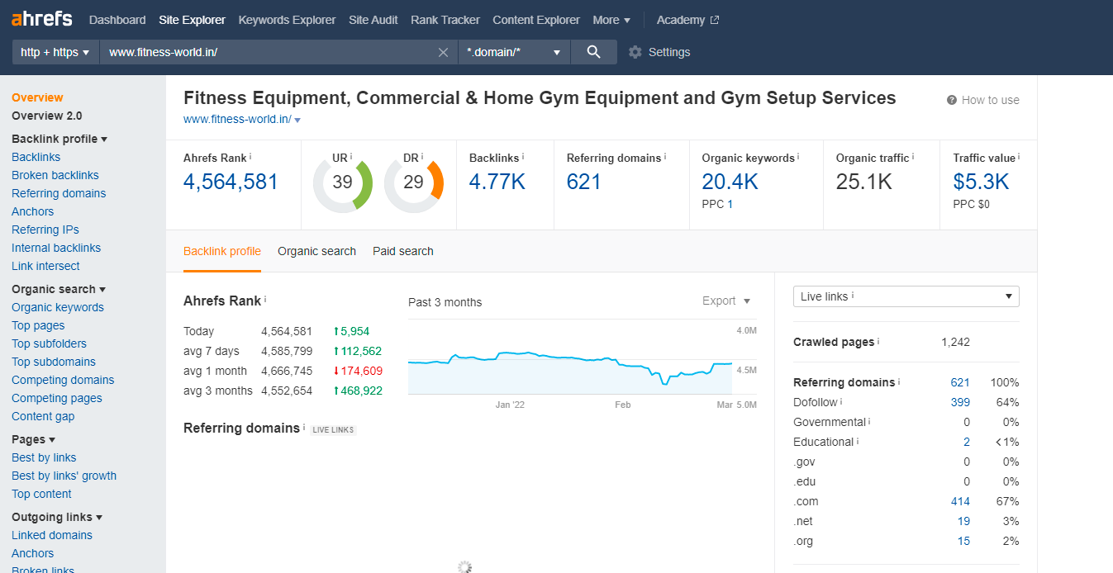
Why does this scope of work arise ?
Fitness World is diverting traffic to their website

Slide 7
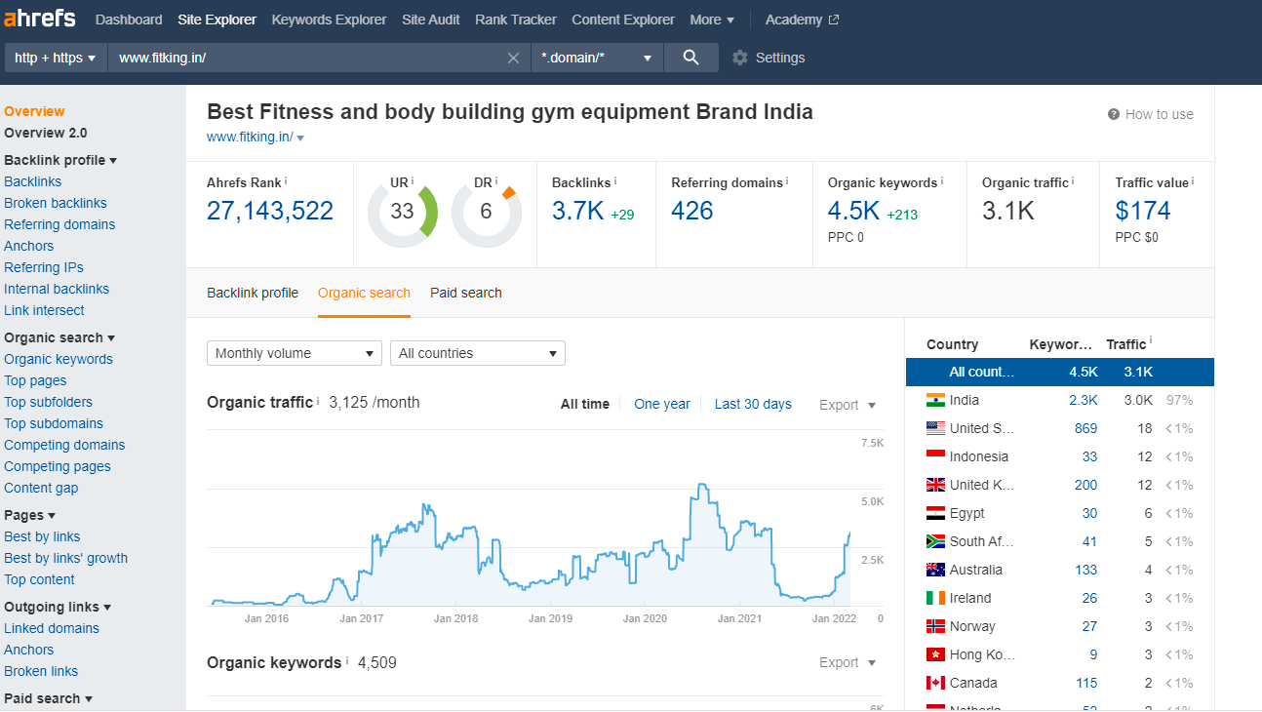
Why does this scope of work arise ?
For Fitking, We Need To Make The Presence Felt

Slide 8
HOW IS THE COMPETITION DRIVING THE TRAFFIC ?
https://ironbullstrength.com/
Average Total Traffic = 36960
Average Organic traffic = 18427
Average Paid traffic = 2893
Average Direct traffic = 14509
Avg. Social Traffic = 621
Avg. Referral Traffic = 511
https://sfhealthtech.com/
Average Total Traffic = 10202
Average Organic traffic = 2721
Average Paid traffic = 680
Average Direct traffic = 5441
Avg. Social Traffic = 680
Avg. Referral Traffic = 680
https://www.fitness-world.in/
Average Total Traffic = 8600
Average Organic traffic = 3374
Average Paid traffic = 260
Average Direct traffic = 4314
Avg. Social Traffic = 332
Avg. Referral Traffic = 320

Slide 9
AN OVERVIEW OF SOCIAL MEDIA
  Iron Bull Strength :
      Instagram Followers – 44.5K
      Facebook Followers – 187K
  SF Healthtech :
      Instagram -20.8K
      Facebook Followers – 6.1K
  Fitness World:
      Instagram -12.9K
      Facebook Followers – 206.5K
  FitKing :
      Instagram Followers – 5K
      Facebook Followers – 111

Slide 10
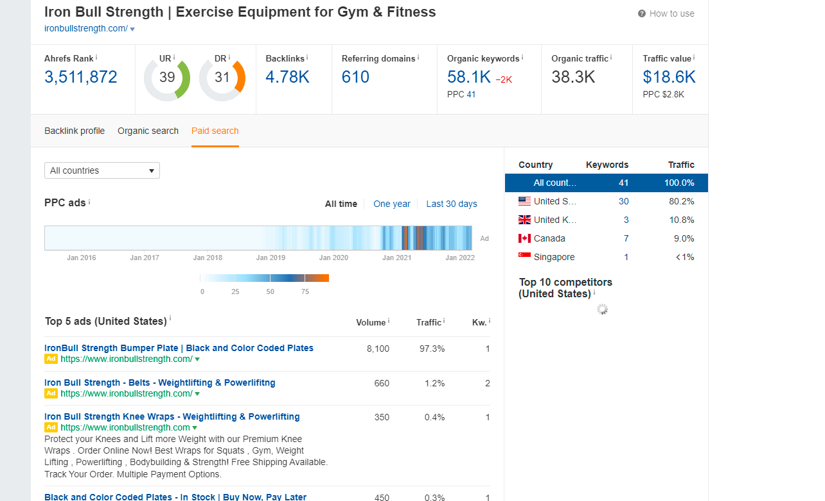
IRON BULL STRENGTH – GOOGLE AD

Slide 11
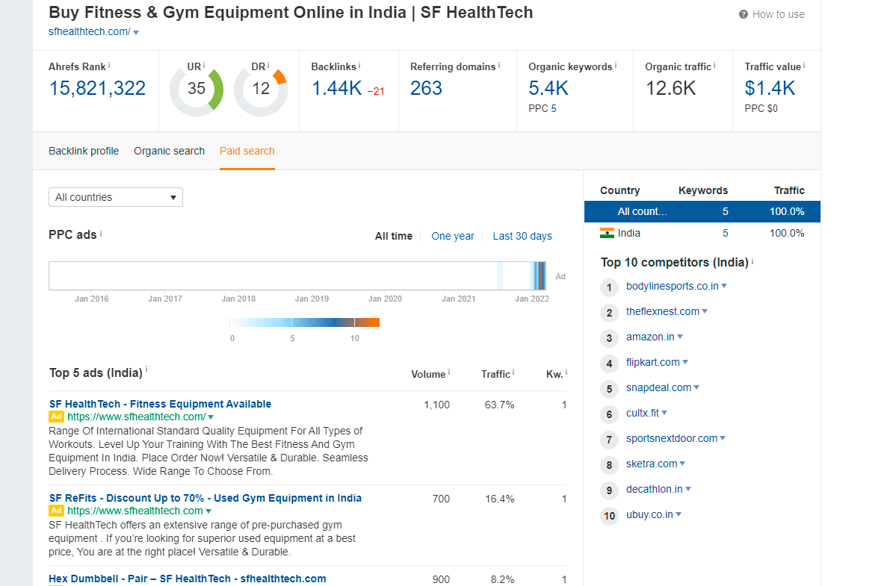
SF HEALTHTECH – GOOGLE AD

Slide 12
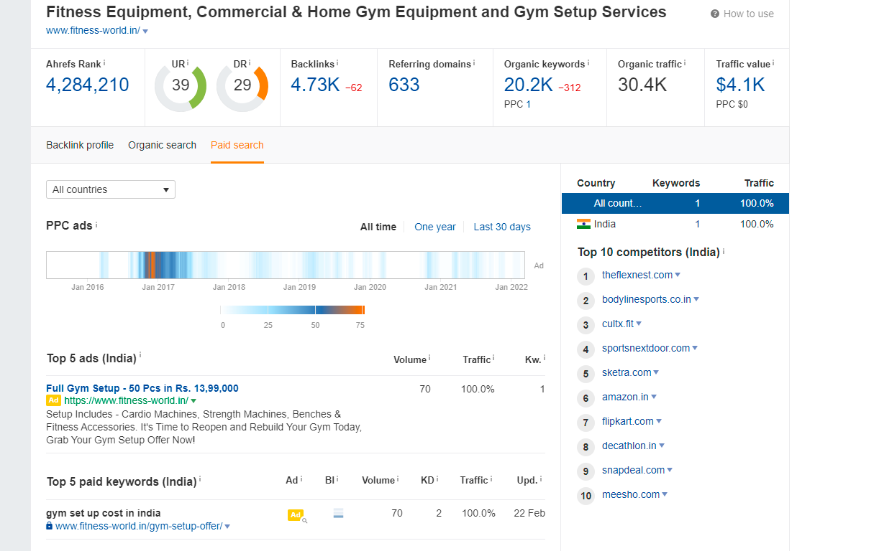
FITNESS WORLD – GOOGLE AD

Slide 13
SOCIAL MEDIA MARKETING FOR FITKING ?
How…… ?

Slide 14
The New Era.
FITKING X QWERTY

Slide 15
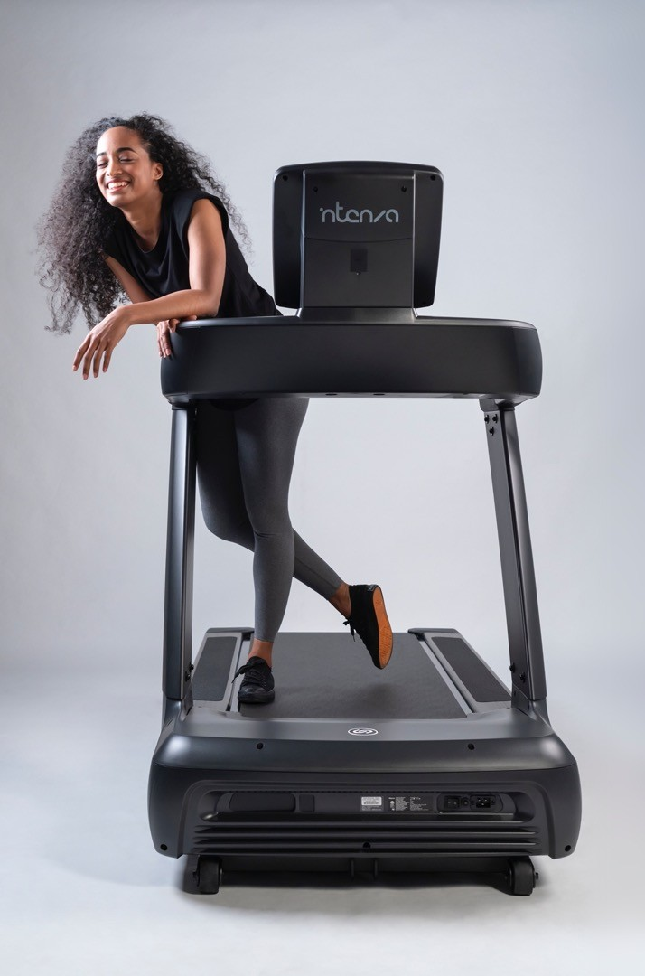
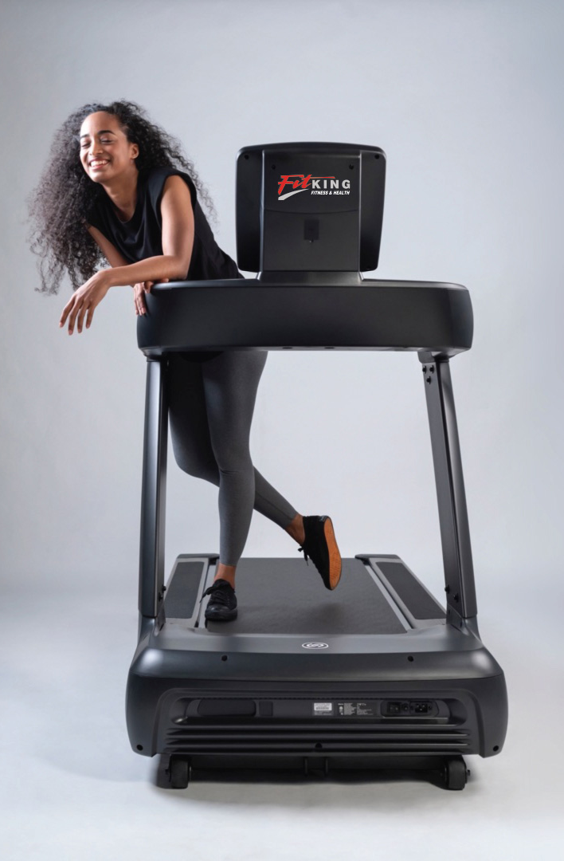
The New Era.
Over the years the consumers have
Hence, they don’t mind spending a little more for a better driven brand.
EVOLVED.
BECAME TECH SAVVY.
PRICE SENSITIVE.
SEEK COMPARATIVE QUALITY.
Quality That Justifies The Price.

Slide 16
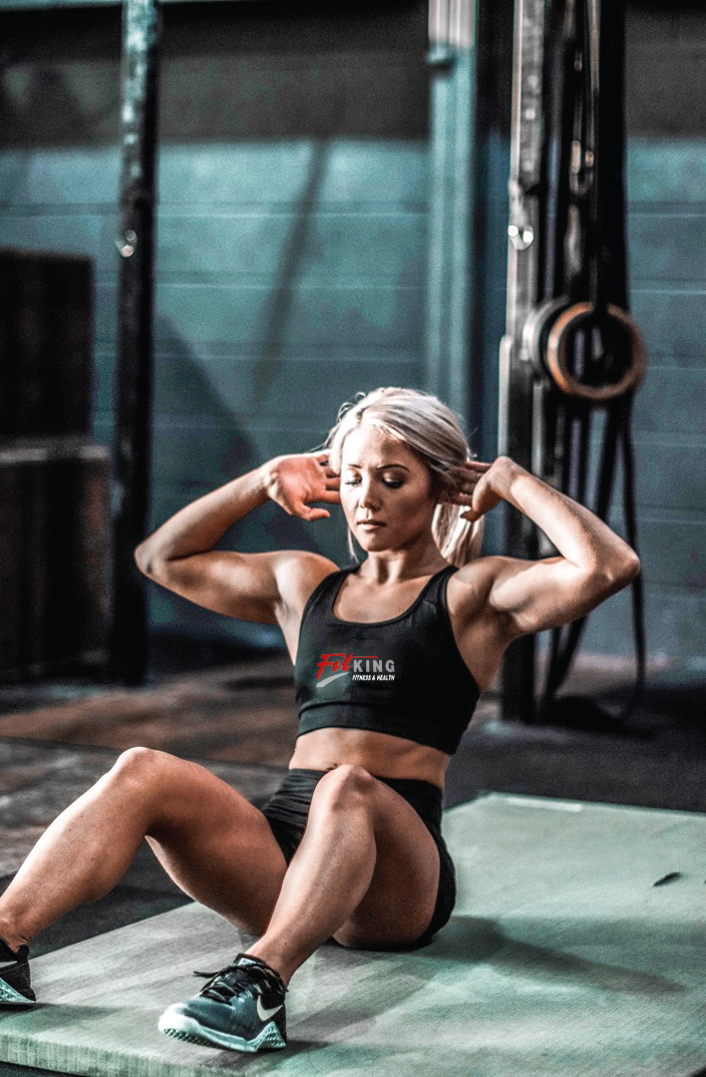
The Problem.
Small players have entered the market and with good social media presence are seizing online and offline sales.

Slide 17
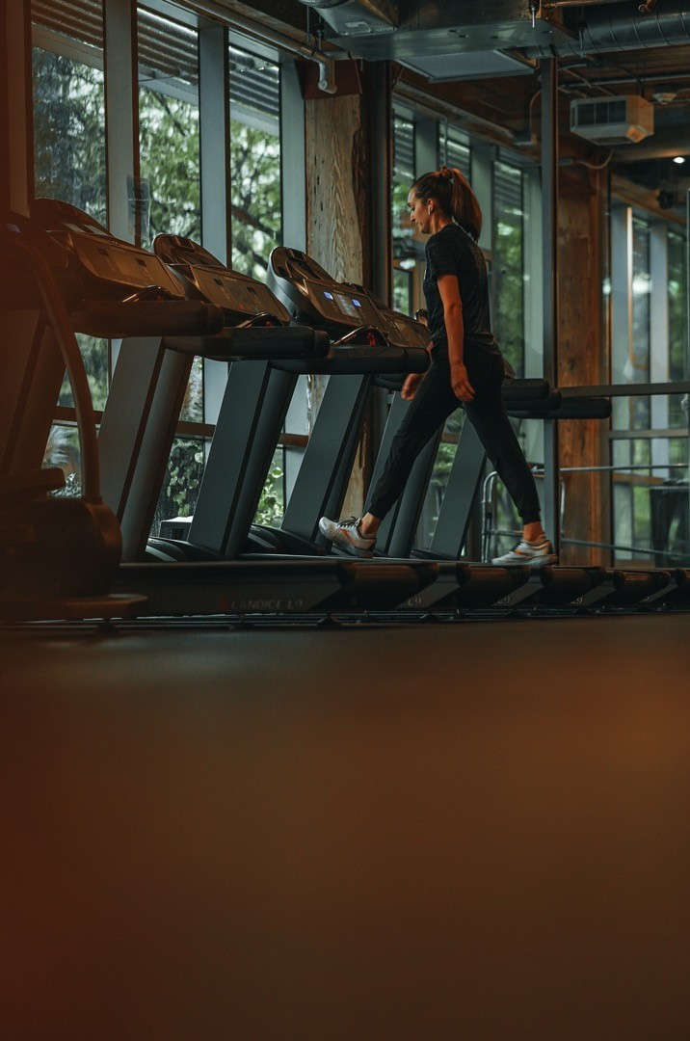

WAY FORWAD FOR
Create a brand that people recognize.
Brand that people want to get associated with.

Slide 18

A BRAND THAT DERIVES THEIR JOURNEY.
MOTIVATES THEM.
GUIDES THEM.
A BRAND WHO KNOWS IT ALL.
MOREOVER, WHY IS IT IN THE BUSINESS!

Slide 19
The Creative Route

Slide 20
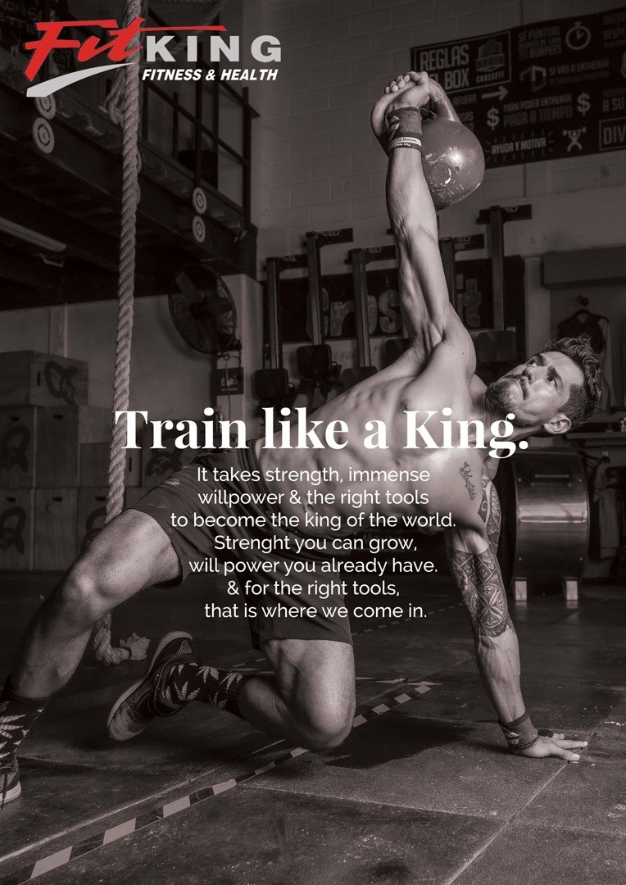
OUR BRAND NAME SAYS IT ALL.
FITKING.
A BRAND THAT COMMUNICATES ABOUT FITNESS.
AND, OUR PRODUCTS BEING JUST THE TOOLS TO ACHIEVE IT.

Slide 21
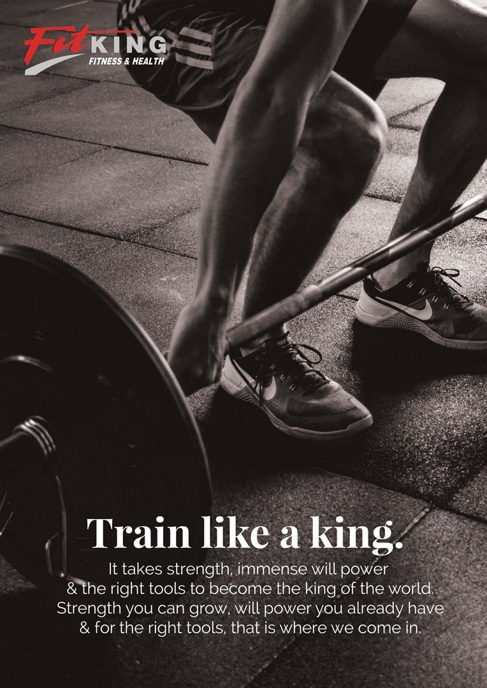
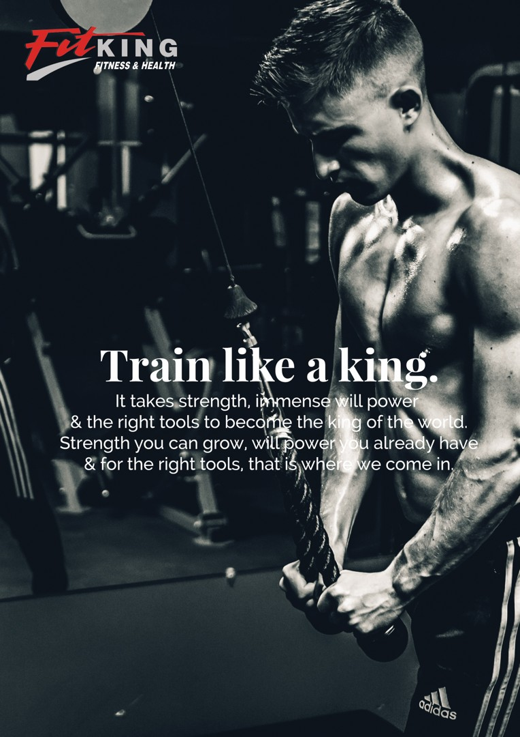

Slide 22
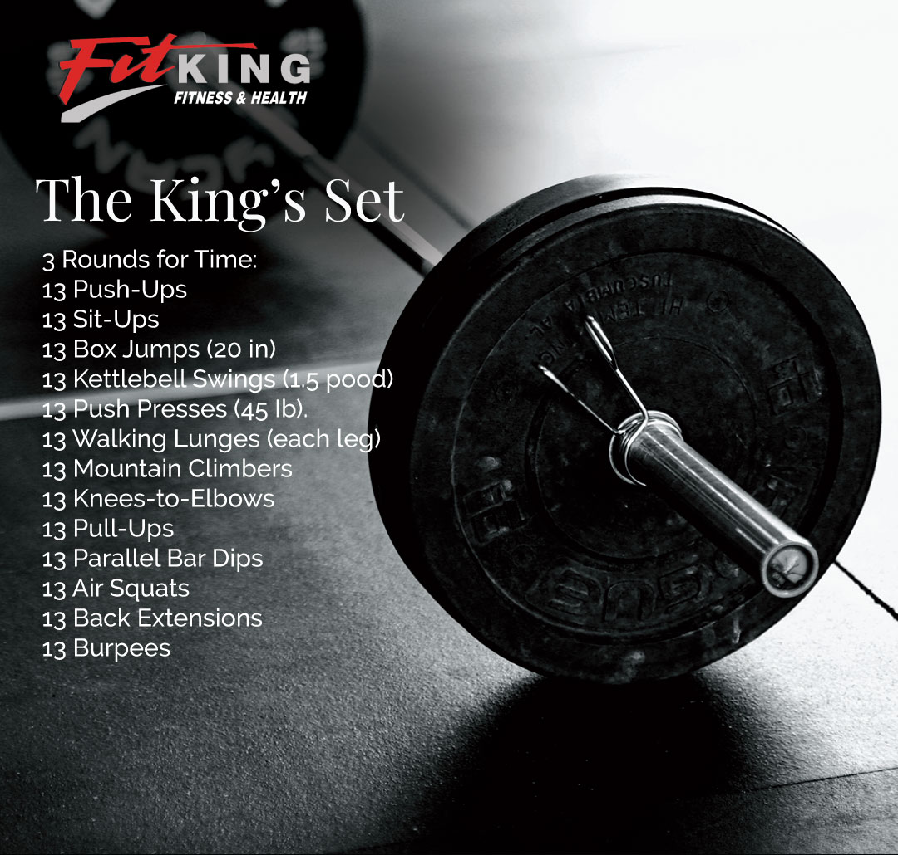
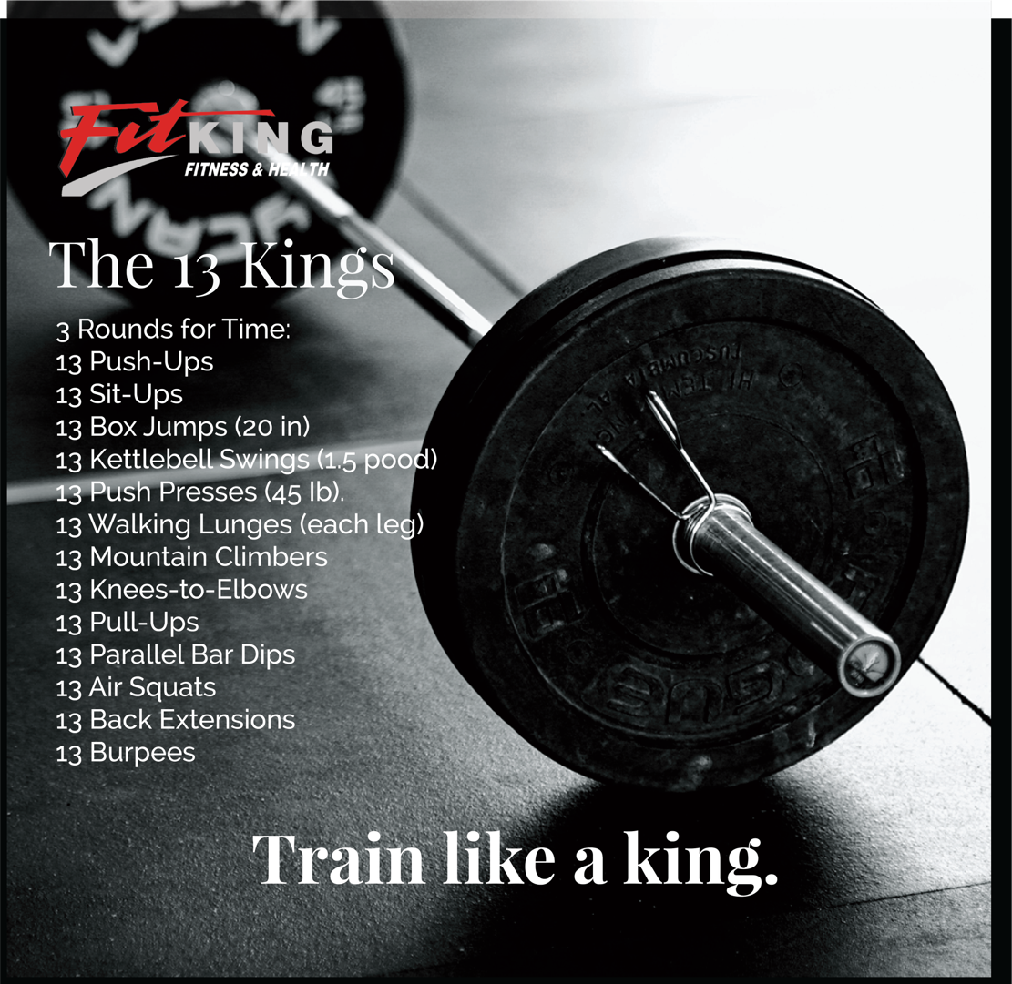

Slide 23
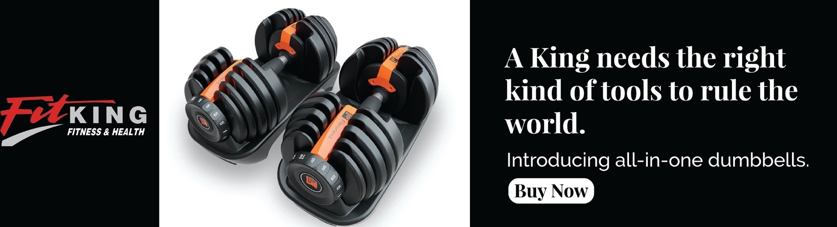

Slide 24
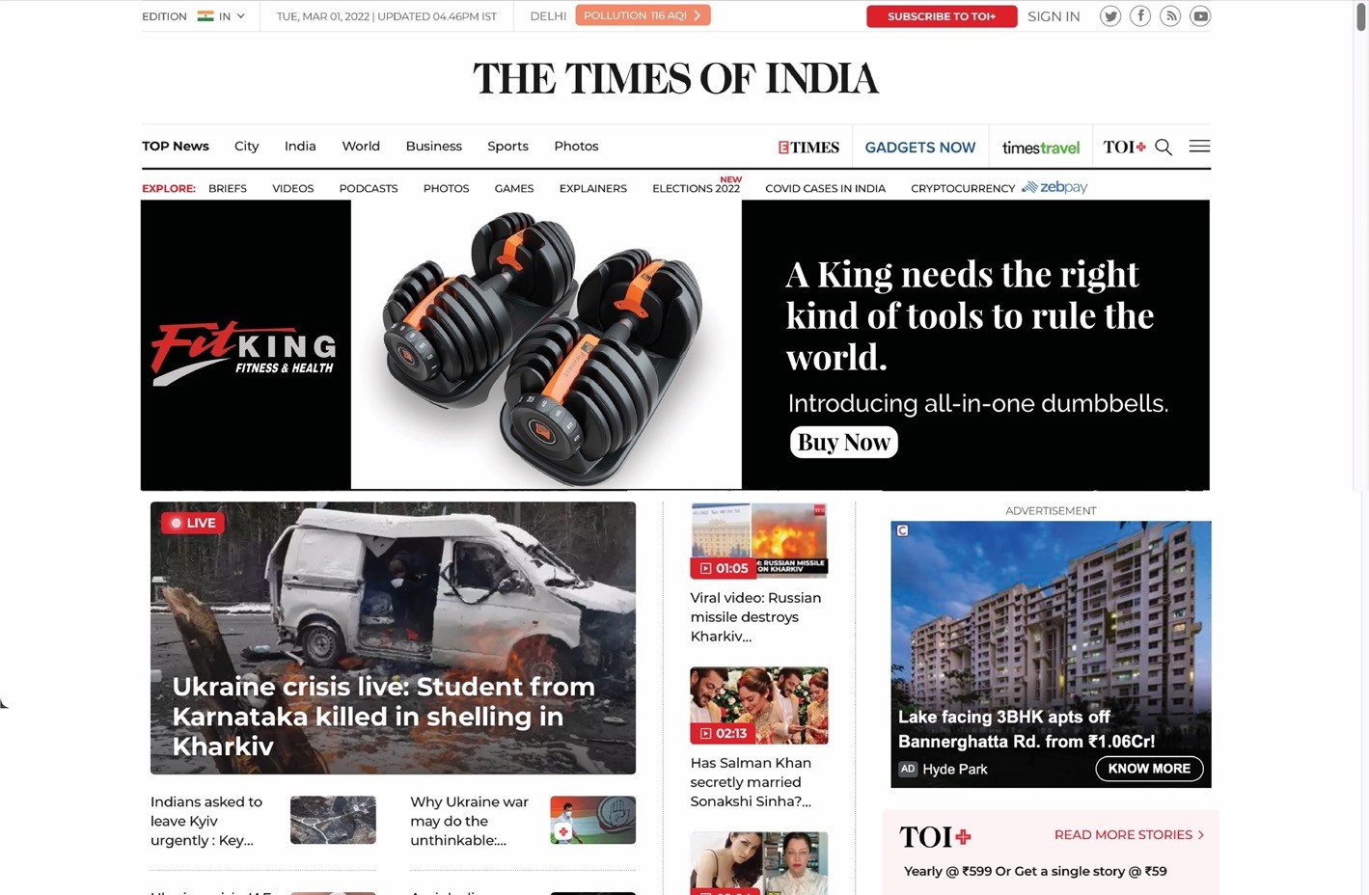

Slide 25

PRICING

Slide 26

“It’s good to have money and the things that money can
buy, but it’s good too, to check up once in a while and make
sure that you haven’t lost the things that money can’t buy.”
—George Lorimer

Slide 27

WEBSITE MAINTENANCE & UPGRADATION
Change All Your Passwords
Create a Complete Backup Of Your Website
Review Security Logs
Troubleshoot Maintenance Tasks
Run Performance Tests
Find & Fix Broken Links
Increase PHP Memory if needed
Update Images
Update Content
Delete Spam Comments
Delete unnecessary Files

Slide 28

Social MediA MArketing
Account Creation & Management on Facebook, Instagram, LinkedIn
Planning and Creation of creatives.
Creating and Posting 15 Creatives in a month.
Post Circulation to 30 unique groups in a month. (Organic Reach)
Post Engagements.
Paid Ad Campaign set up and monitoring.
Creating Ad copies for paid ad campaign.
Monthly evaluation of performance of the pages.
Cost of campaign will be borne by the client. We will suggest the amount to be spent for any campaign.

Slide 29
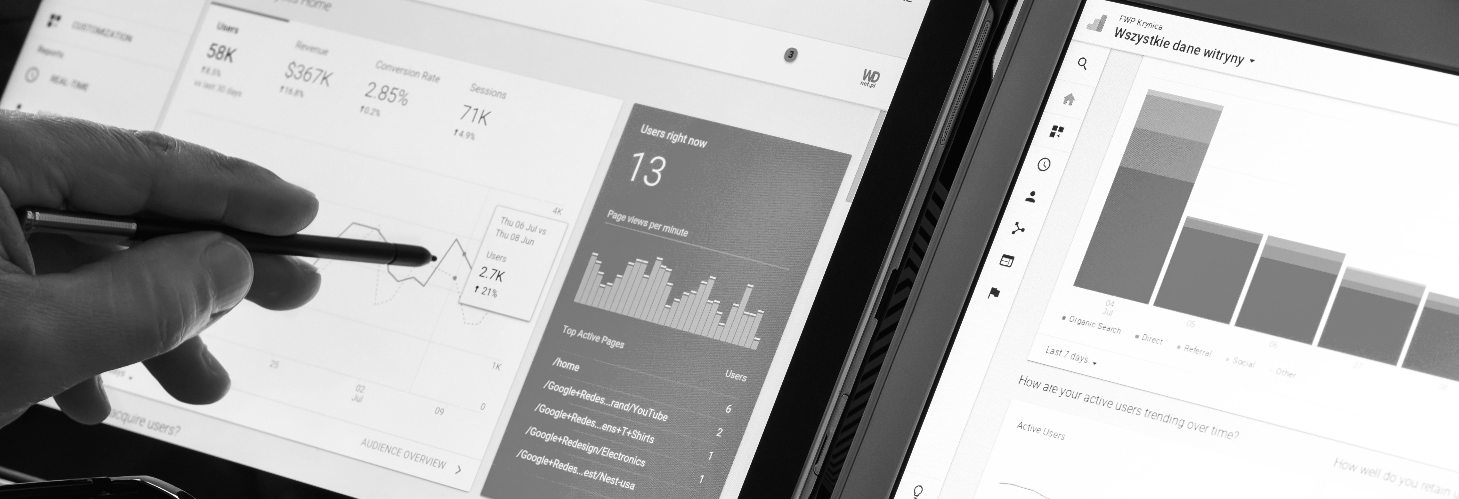

Google Ads
Google Ad Creation
Google Ad Campaign set up.
Campaign Monitoring and Change
ROI Tracking and Reporting .
Cost of campaign will be borne by the client. We will suggest the amount to be spent for any campaign.

Slide 30
SEO
Competitor Analysis
Keyword Research
Website Penalty Analysis
Backlink Analysis
Google Analytic Integration
Google Search Console Integration
Brand Building Blogs And Articles
On Page Seo
Off Page Seo
Link Building Activities
Bookmarking Submission
PR And Feed Submission
Profile Creation
Directory Submission
Video And Ppt Submission

Slide 31
THIRD PARTY Service (AMAZON)
Seller Central Account Setup
Product Listing
Product Optimization
Brand Registry and Protection
Inventory Management
Account Health Management
Product Image Designing & Editing Services
Amazon SEO Services
A+ Content
Cost of campaign will be borne by the client. We will suggest the amount to be spent for any campaign.

Slide 32
THIRD PARTY Service (AMAZON)
Storefront
Sponsored Brand Ads
Amazon Product Research
Product Descriptions
Key Word Research For products
FBA Listing
Prime Seller Listing
Cost of campaign will be borne by the client. We will suggest the amount to be spent for any campaign.

Slide 33
Thank you.

